Slide 1
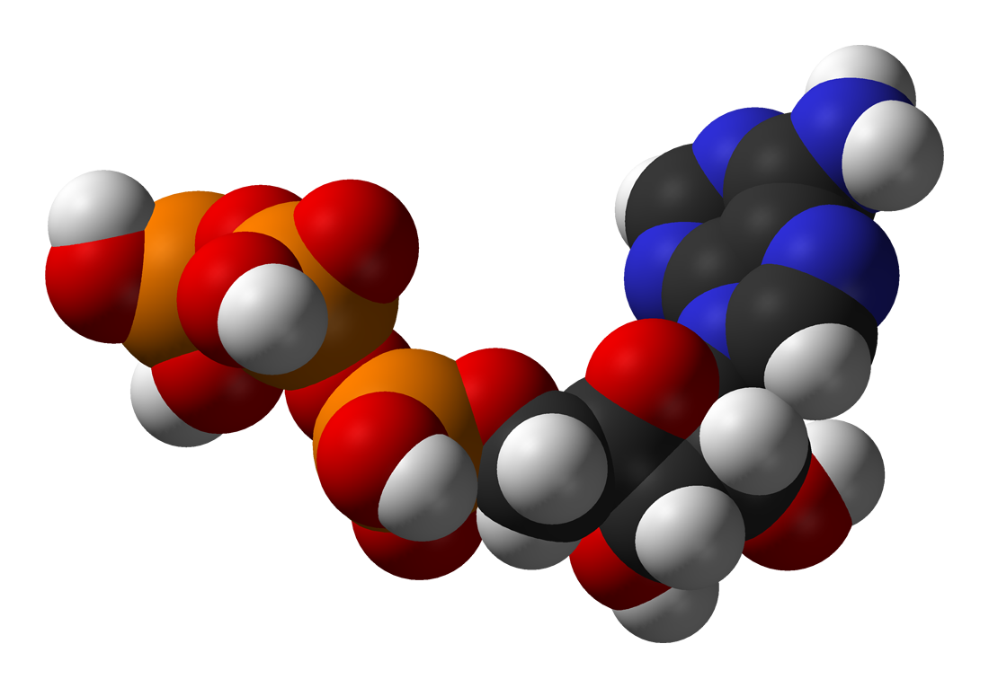
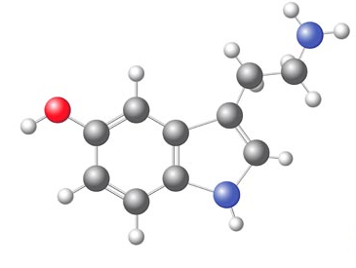
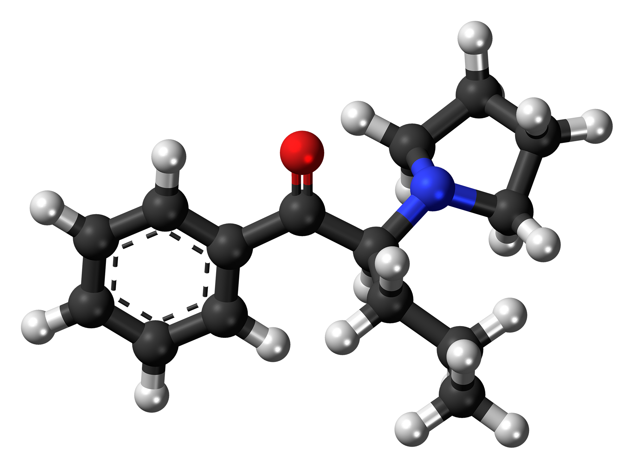
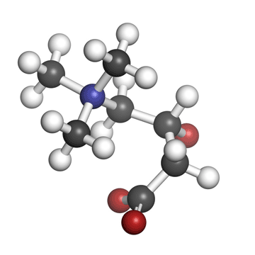
Metabolomics
FOS Molecular Data Science 2019
Marian Beekman
Molecular Epidemiology
LUMC

Slide 2

Learning goals
After todays lectures and practical you
Can explain the different levels of omics data that are used for disease prediction
Can explain the strength of the use of metabolomics in disease prediction
Can explain the weaknesses of the use of metabolomics in disease prediction
Understand the workflow of -omics data analysis
Can explain relevant steps in quality control of metabolomics
Know which databases may contribute to the interpretation of results

Slide 3
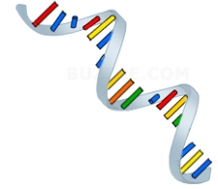
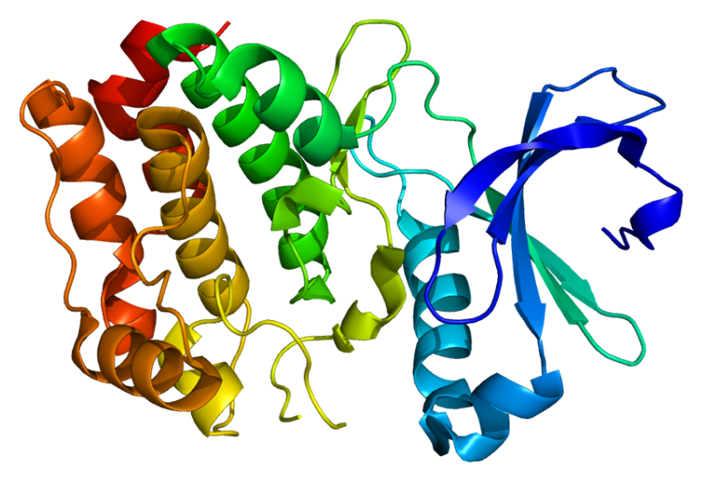
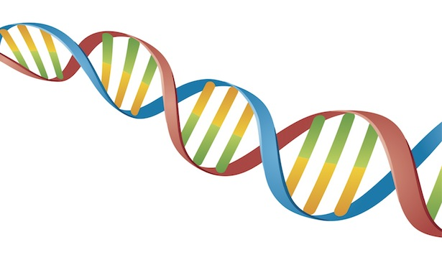
The central dogma of biology
Genome ~25 K genes
Transcriptome ~100 K transcripts
Proteome ~1000 K proteins
Metabolome ~25 K small molecules
DNA
RNA
Protein
Biochemicals
Transcription
Translation
Metabolism
Mutations
Epigenetic modifications
Post-transcriptional modification
Post-translational modification
Bioinformatics
Biomarker identification
Notes:
Nature Reviews Molecular Cell Biology 13, 263-269 (April 2012) | doi:10.1038/nrm3314
a | Whereas genes and proteins are subject to regulatory epigenetic processes and post-translational modifications, respectively, metabolites represent downstream biochemical end products that are closer to the phenotype. Accordingly, it is easier to correlate metabolomic profiles with phenotype compared to genomic, transcriptomic and proteomic profiles.

Slide 4

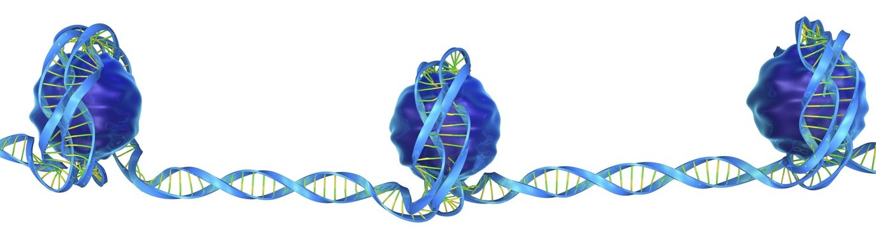
Different -omics levels
Metabolome
Genome
Transcriptome
Epigenome
Proteome
Phenotype
Lifestyle
Nutrition
Environment

Slide 5
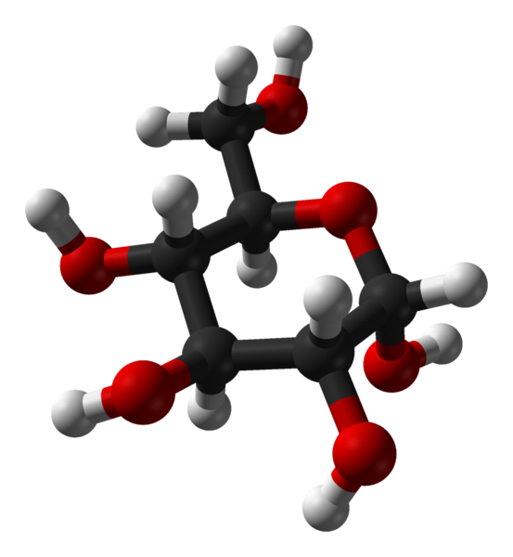
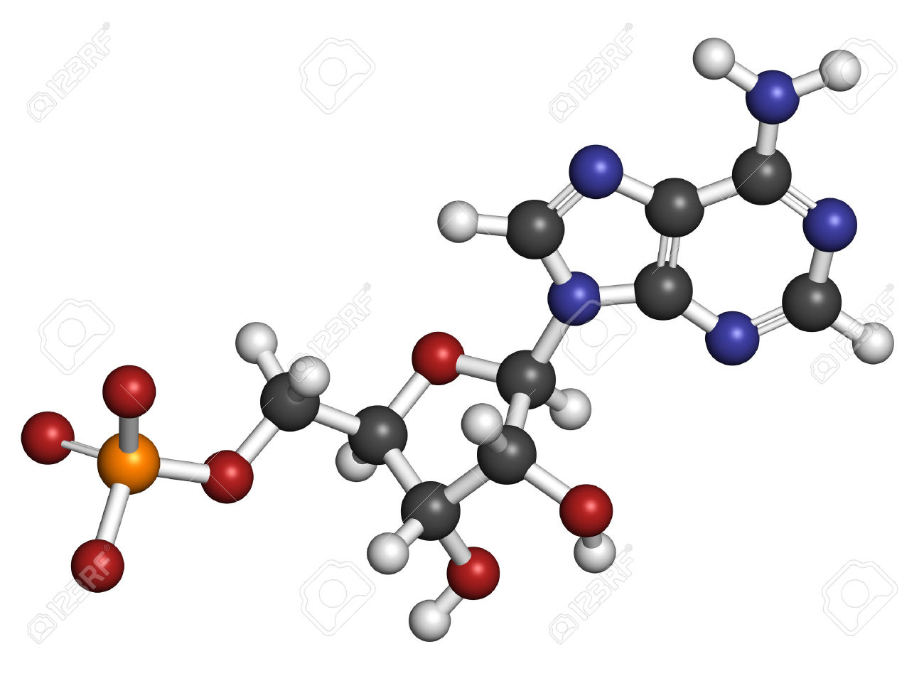
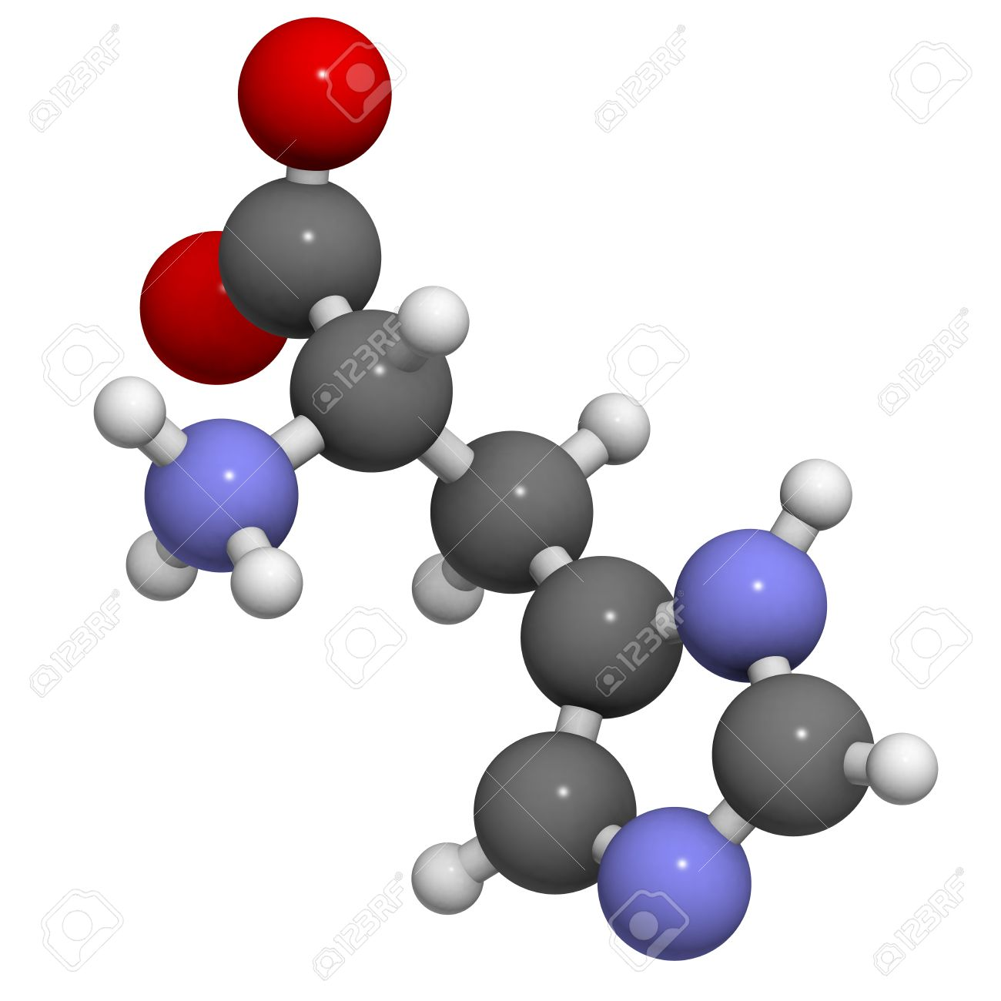
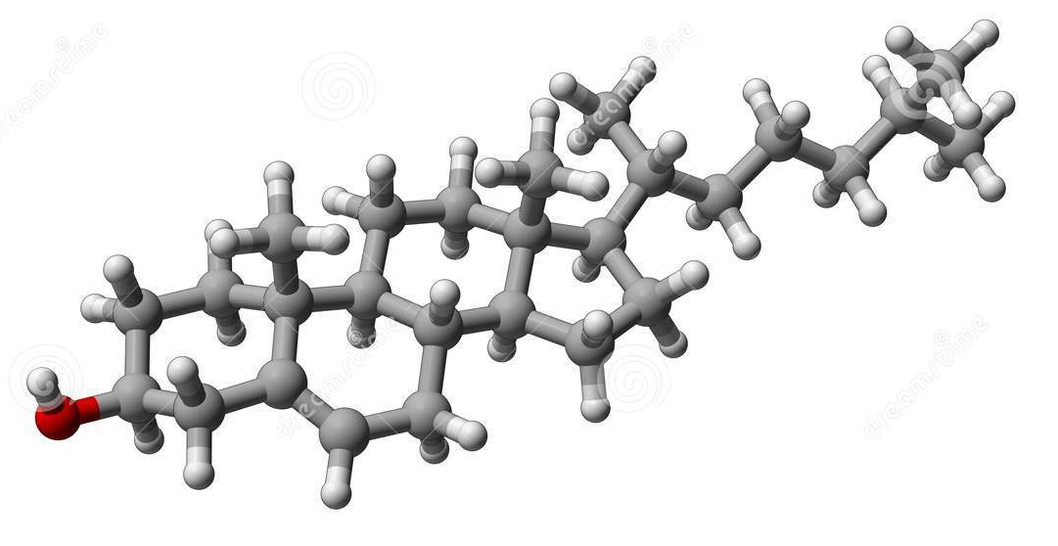
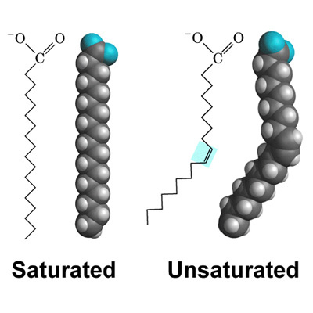
Metabolome
Sugars
Nucleotides
Amino Acids
Lipids
Metabolites
Notes:
Metabolomics is a powerful approach because metabolites and their concentrations, unlike other "omics" measures, directly reflect the underlying biochemical activity and state of cells / tissues. Thus metabolomics best represents the molecular phenotype.
https://www.ebi.ac.uk/training/online/course/introduction-metabolomics/what-metabolomics

Slide 6
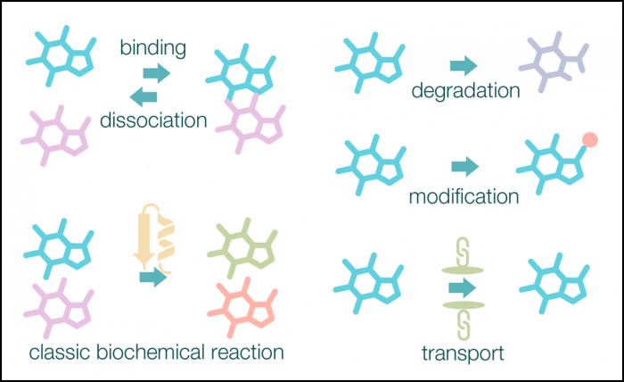
Snaphot in time…
Notes:
https://www.ebi.ac.uk/training/online/course/introduction-metabolomics/what-metabolomics
The metabolome is the complete set of metabolites within a cell, tissue or biological sample at any given time point. The metabolome is inherently very dynamic: small molecules are continuously absorbed, synthesised, degraded and interact with other molecules, both within and between biological systems, and with the environment (Figure 3).
Metabolomics - a 'snapshot' in time
Many reactions take place continuously within cells, so concentrations of metabolites are considered to be very dynamic, and may change rapidly from one time point to the next. Current analytical techniques used to investigate metabolomics can only take a snapshot in time under a set of defined conditions.
Biomarker discovery is another area where metabolomics informs decision making. Biomarkers are "objective indications of medical state observed from outside the patient - which can be measured accurately and reproducibly" (Kyle et al. What are Biomarkers?). In metabolomics, biomarkers are small molecules (metabolites) that can be used to distinguish two groups of samples, typically a disease and control group. For example, a metabolite reliably present in disease samples, but not in healthy individuals would be classed as a biomarker. Samples of urine, saliva, bile, or seminal fluid contain highly informative metabolites, and can be readily analysed through metabolomics fingerprinting or profiling, for the purpose of biomarker discovery.
Personalised medicine
Personalised medicine, the ultimate customisation of healthcare, requires metabolomics for quick medical diagnosis to identify disease. In healthcare, we currently use classical biochemical tests to measure individual metabolite concentrations to identify disease states (e.g. the blood-glucose level in the case of diabetes). Metabolomics offers the potential for the rapid indentification of hundreds of metabolites, enabling us to identify these disease states much earlier.

Slide 7
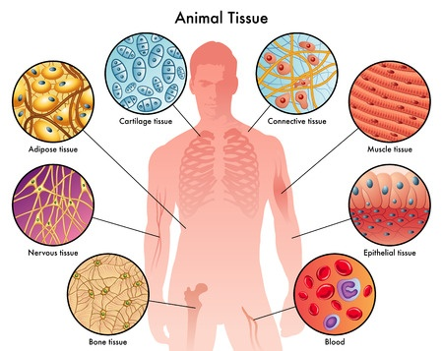
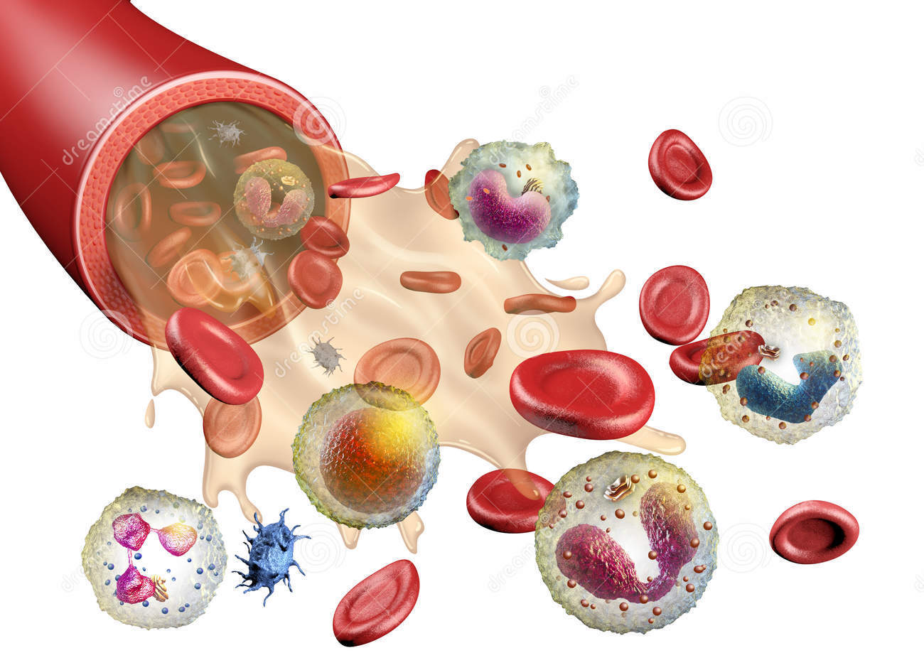
Snaphot in tissues…
Blood plasma

Slide 8
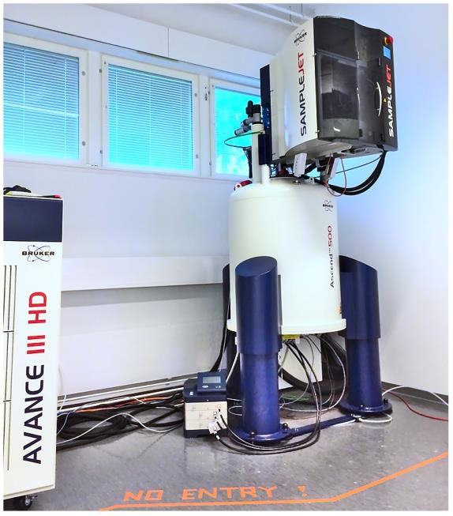
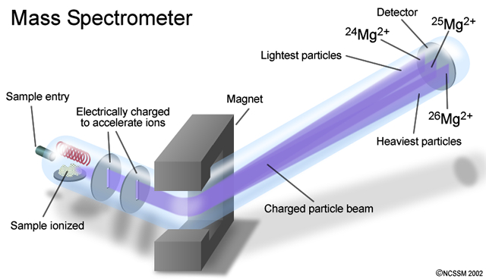
Methods to measure metabolomics
Mass Spectometry (separation on mass)
Nuclear Magnetic Resonance (separation on the capacities of absorbsion and re-emission of electromagnetic radiation)

Slide 9



Nightingale Health

Slide 10
Nightingale Health (formerly known as Brainshake)

Slide 11
Nightingale Health (formerly known as Brainshake)

Slide 12
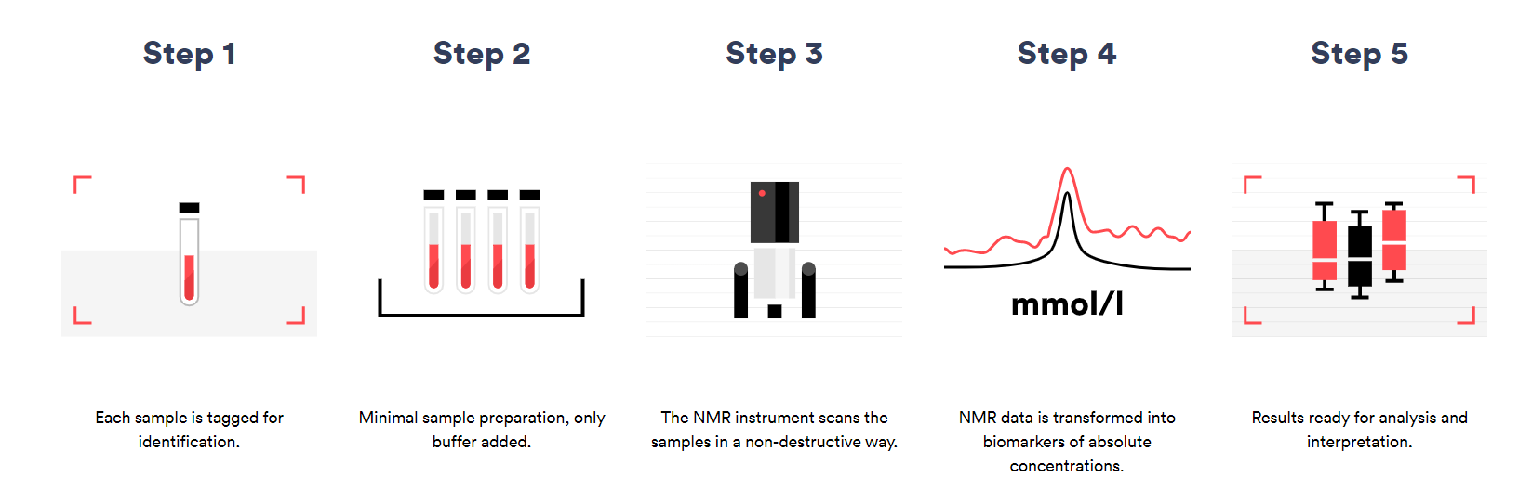
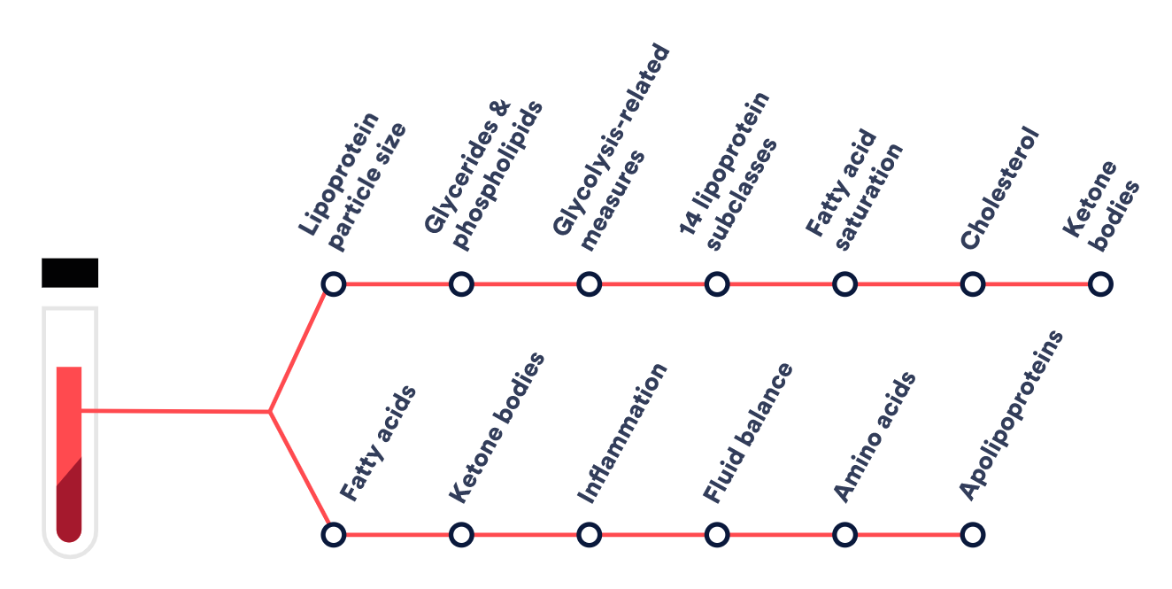
Nightingale Health

Slide 13
Nightingale Health (formerly known as Brainshake)

Slide 14

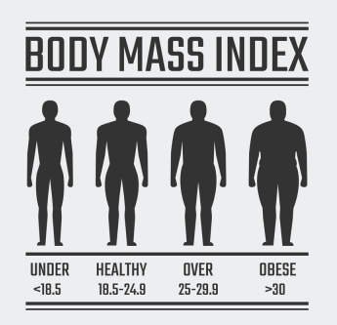
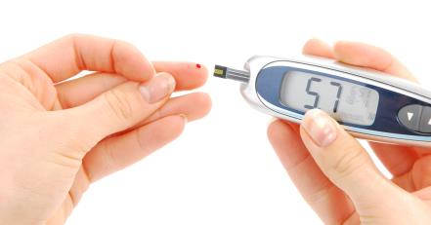
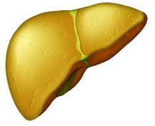

Metabolomics association with disease
Metabolomics

Slide 15
Metabolomics association with disease
Metabolomics

Slide 16
Metabolomics association with disease
Metabolomics

Slide 17
Metabolomics association with disease
Metabolomics

Slide 18
Metabolomics association with disease
Metabolomics

Slide 19
Learning goals
After todays lectures and practical you
Can explain the different levels of omics data that are used for disease prediction
Genetics, epigenetics, transcriptomics, proteomics, metabolomics
Can explain the strength of the use of metabolomics in disease prediction
Metabolites represent downstream biochemical end products that are closer to the phenotype, because they are also reflect environmental factors
Can explain the weaknesses of the use of metabolomics in disease prediction
Snaphot in time and tissue (maybe it was not the best moment or tissue to investigate)

Slide 20
Learning goals
After todays lectures and practical you
Can explain the different levels of omics data that are used for disease prediction
Can explain the strength of the use of metabolomics in disease prediction
Can explain the weaknesses of the use of metabolomics in disease prediction
Understand the workflow of -omics data analysis
Explain relevant steps in quality control of metabolomics
Know which databases may contribute to the interpretation of results

Slide 21
Omics data analysis workflow
Data
Analyses
Hypothesis
Paper Writing
Begin writing after decision about the paper proposal
Deliver data for analyses
Conclusion/message
Journal
Exploration
Development of Exploration plan
Development of Analysis plan
Literature study
Visualization
Performing analyses
Quality Control
Which answers may be in the data?
Development of paper proposal
Visualization
Literature study
Delivery and archiving of results
Generation of data
Develop research question

Slide 22
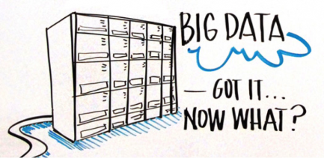
Data
Sample size
How many subjects do I have?
Number of men, women?
What is the mean age of the subjects?
Is the range of measures in the phenotype as expected?

Slide 23

Quality Control: Subject level
Are there subject with many missing values?
Are there subjects with QC flags from the measurement?
Decide before analysis what to do with such data!

Slide 24
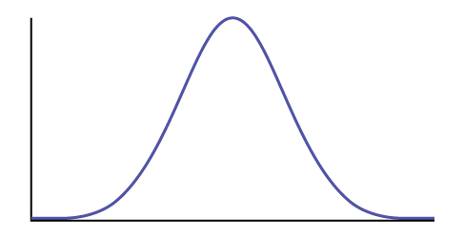
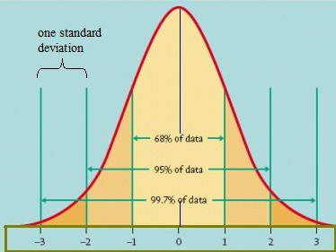
Quality Control: Metabolite level
Are there metabolites missing for many subjects?
Are the metabolites with many zero-values?
Decide before analysis what to do with such data!
Are the distributions of all metabolites normal?
Detection threshold

Slide 25
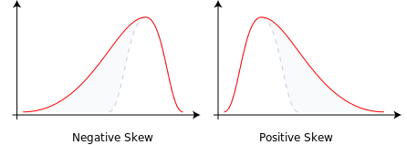
Quality Control: Metabolite level
Are there metabolites missing for many subjects?
Are the metabolites with many zero-values?
Decide before analysis what to do with such data!
Are the distributions of all metabolites normal?
Metabolite level (Y) = Constant + (β₁ x Sex) + (β₂ x Age)
N.B. The outcome of linear regression is assumed to have a normal distribution!
Notes:
Rank Inverse Normal distribution

Slide 26
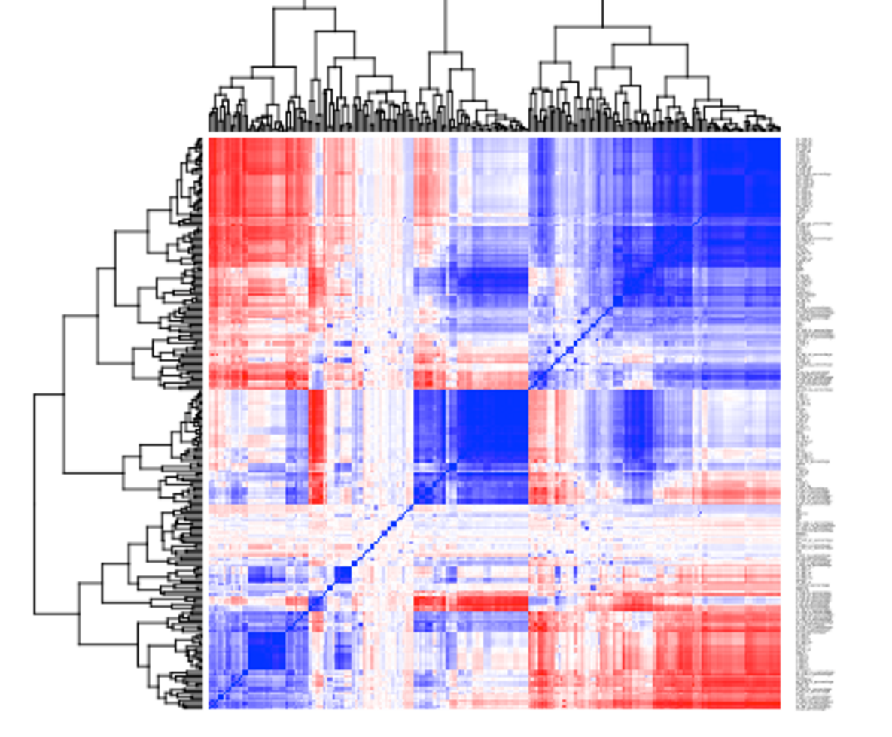
Statistical analysis
Linear regression
How large is effect size (β₁ )?
What is the significance threshold?
Bonferoni: p-value = 0.05/number of independent tests
Metabolite level (Y) = Constant + (β₁ x Sex) + (β₂ x Age)
How many independent tests?!

Slide 27
Number of independent tests
1
4
~45 clusters:
Significance threshold = 0.05/45 = 0.001
5
20
22
40

Slide 28
Metabolomics analyses and interpretation
Diseases and phenotypes
Metabolomics
Cross-sectional: Linear regression
Y (Metabolite concentrations) = C + (β₁ x Disease) + (β₂ x Age) + (β₃ x Sex)
Prospective/Prediction: Cox- regression
Ln(H(t)/H₀(t)) (Hazard for disease) = (β₁ x Metabolite conc) + (β₂ x Age) + (β₃ x Sex)

Slide 29
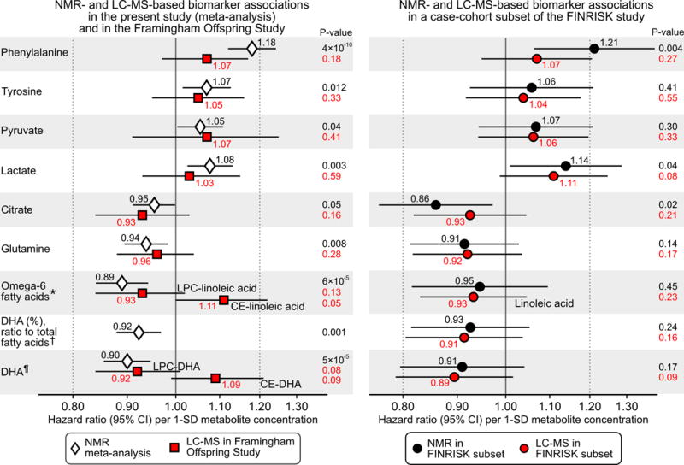
Metabolomics analyses and interpretation
Notes:
PMC full text:Circulation. Author manuscript; available in PMC 2016 Mar 3.Published in final edited form as:
Würtz et al. Circulation. 2015 Mar 3; 131(9): 774–785.
Published online 2015 Jan 8. doi: 10.1161/CIRCULATIONAHA.114.013116
Figure 6:
Consistency between NMR and LC-MS for biomarker associations with incident cardiovascular disease. Metabolites overlapping between metabolomics platforms and nominally associated with incident CVD in the present study (P<0.05, Supplemental Figure 6) are shown. Left panel: Biomarker associations with CVD risk observed in the present study based on NMR (white diamonds) compared with those obtained in the Framingham Offspring Study based on LC-MS (red squares; n=2289, 466 events). Right panel: Biomarker associations with CVD risk in a case-cohort subset of the FINRISK study (n=679, 305 events) profiled both by NMR (black circles) and LC-MS (red circles). Hazard ratios are per 1-SD higher log-transformed metabolite concentration. Errorbars denote 95% confidence intervals. All associations were adjusted for age, sex, blood pressure, smoking, diabetes status, geographical region, cardiovascular medication as well as total and HDL cholesterol. LC-MS-based associations were further adjusted for batch. The corresponding age- and sex-adjusted biomarker associations are shown in Supplemental Figure 10. *Associations of omega-6 fatty acids were compared with lysophosphatidylcholine- and cholesterolester-linoleic acid in the Framingham Offspring Study, and with total linoleic acid in the FINRISK subset. † Associations of DHA were compared with lysophosphatidylcholine- and cholesterolester- DHA in the Framingham Offspring Study. ¶ DHA ratio was scaled to the total fatty acid concentration quantified by NMR for both platforms. The DHA ratio was not measured in the Framingham Offspring Study.

Slide 30
Metabolomics analyses and interpretation
Diseases and phenotypes
MWAS
Metabolomics
GWAS
TWAS
Genetic loci
EWAS
Gene expression
DNA methylations sites
Notes:
Nat Genet. 2012 Jan 29; 44(3): 269–276.
Published online 2012 Jan 29. doi: 10.1038/ng.1073
The heritability estimates and proportion of variance explained for all traits. Heritability estimates are presented for lipids, small molecules, ratios used in this study and lipoproteins. Labels in the lipoprotein subclasses describe the properties measured in each subfraction (P, concentration of particles; L, total lipids; PL, phospholipids; C, total cholesterol; CE, cholesterol esters; FC, free cholesterol; TG, triglycerides). Abbreviations are explained in detail in Supplementary Table 1.
Associations between DNA methylation (450,000 CpGs) and BRAINSHAKE metabolomics
Initiated by the University of Oulu 8 cohorts (n > 6000)
LifeLines, Leiden Longevity Study, Netherlands Twin Register, Rotterdam Study, FINRISK, KORA, ALSPAC and NFBC
EWAS according to Lehne et al. 2015. Genome Biology
Covariates: gender, age, cell counts, BMI, smoking status, lipid-lowering medication use, diabetes

Slide 31
GWAS: genetic loci associating with metabolomics
Notes:
Nat Genet. 2012 Jan 29; 44(3): 269–276.
Published online 2012 Jan 29. doi: 10.1038/ng.1073
The heritability estimates and proportion of variance explained for all traits. Heritability estimates are presented for lipids, small molecules, ratios used in this study and lipoproteins. Labels in the lipoprotein subclasses describe the properties measured in each subfraction (P, concentration of particles; L, total lipids; PL, phospholipids; C, total cholesterol; CE, cholesterol esters; FC, free cholesterol; TG, triglycerides). Abbreviations are explained in detail in Supplementary Table 1.

Slide 32
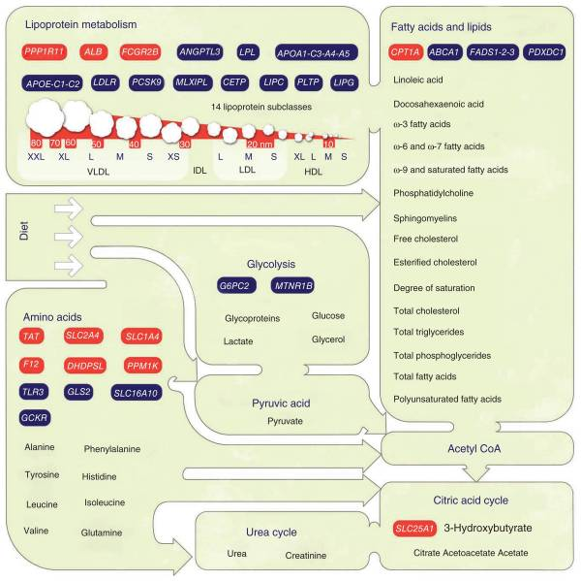
GWAS: genetic loci associating with metabolomics
Notes:
Nat Genet. 2012 Jan 29; 44(3): 269–276.
Published online 2012 Jan 29. doi: 10.1038/ng.1073
Overall summary of basic metabolism, key constituents of the NMR-measurable serum metabolome and associated genetic loci. The green shapes represent various dietary ingredients and systemic metabolic measures reflecting human body functions. A key selection of metabolites quantified in each metabolic category is given. Red rectangles represent the newly identified genetic loci found in this work, and blue rectangles indicate loci that were previously identified. The genes are categorized by the lead trait associations given in Tables 2 and ​and3.3. In particular, ALB and FCGR2B were associated with serum cholesterol, PPP1R11 with very high VLDL measures, CPT1A with the LA/PUFA ratio, SLC25A1 with citrate, F12 with phenylalanine, TAT with tyrosine, DHDPSL with glutamine, SLC1A4 with valine and PPM1K and SLC2A4 with Fischer’s ratio.

Slide 33
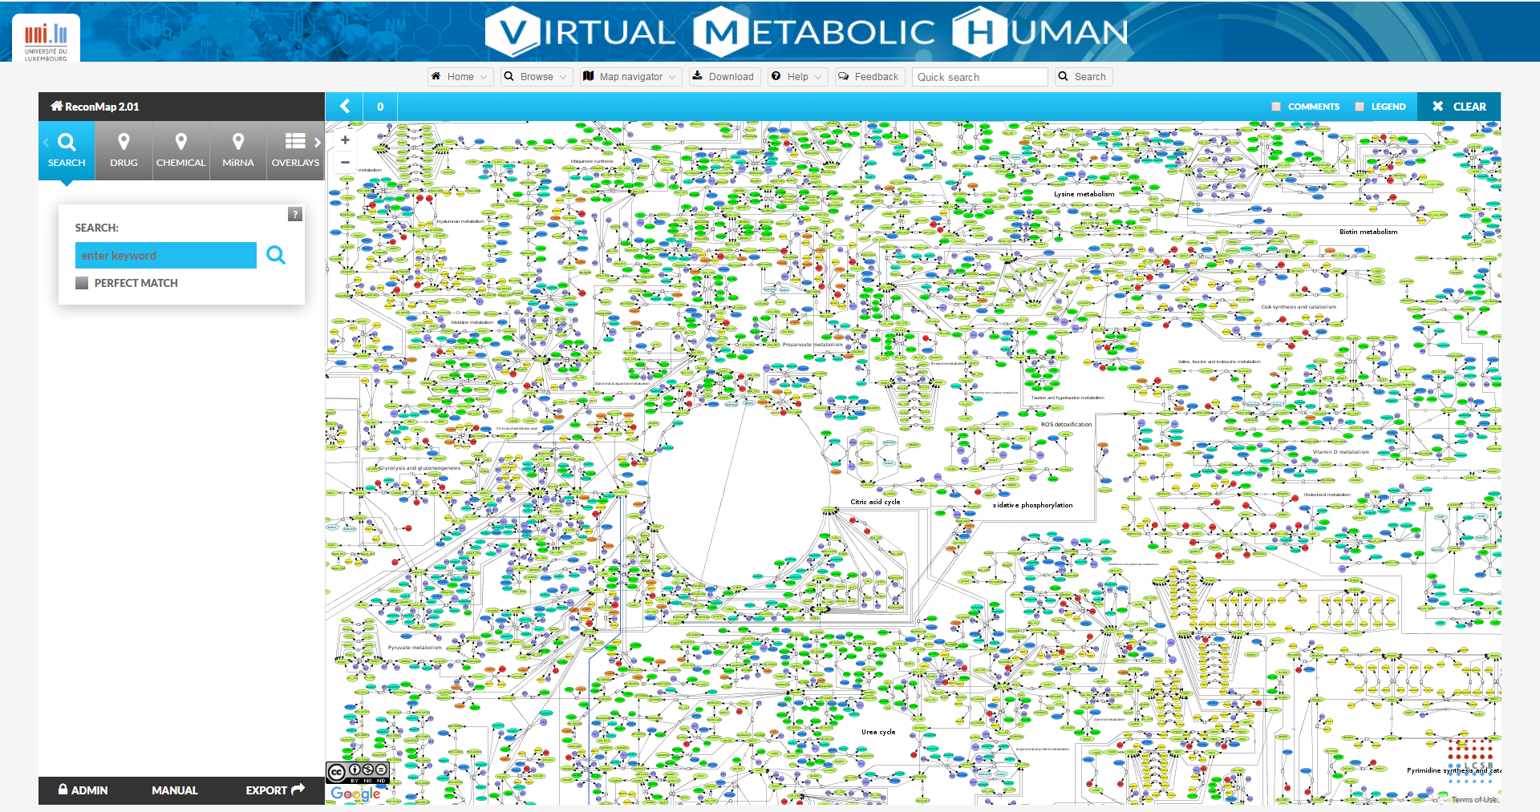
Virtual Metabolome Human
http://vmh.uni.lu/#reconmap
Notes:
Nat Genet. 2012 Jan 29; 44(3): 269–276.
Published online 2012 Jan 29. doi: 10.1038/ng.1073
Overall summary of basic metabolism, key constituents of the NMR-measurable serum metabolome and associated genetic loci. The green shapes represent various dietary ingredients and systemic metabolic measures reflecting human body functions. A key selection of metabolites quantified in each metabolic category is given. Red rectangles represent the newly identified genetic loci found in this work, and blue rectangles indicate loci that were previously identified. The genes are categorized by the lead trait associations given in Tables 2 and ​and3.3. In particular, ALB and FCGR2B were associated with serum cholesterol, PPP1R11 with very high VLDL measures, CPT1A with the LA/PUFA ratio, SLC25A1 with citrate, F12 with phenylalanine, TAT with tyrosine, DHDPSL with glutamine, SLC1A4 with valine and PPM1K and SLC2A4 with Fischer’s ratio.

Slide 34
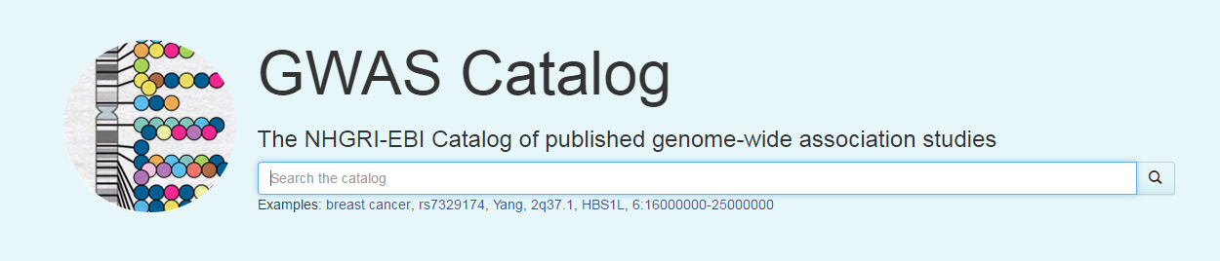
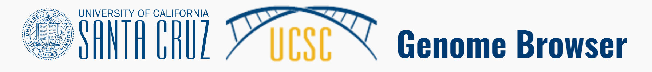
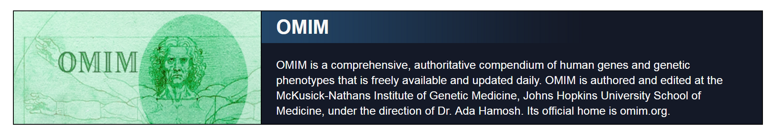
Interpretation and building hypothesis
http://vmh.uni.lu/#reconmap
https://www.ebi.ac.uk/gwas/
https://genome.ucsc.edu/
https://www.ncbi.nlm.nih.gov/omim
Notes:
Nat Genet. 2012 Jan 29; 44(3): 269–276.
Published online 2012 Jan 29. doi: 10.1038/ng.1073
Overall summary of basic metabolism, key constituents of the NMR-measurable serum metabolome and associated genetic loci. The green shapes represent various dietary ingredients and systemic metabolic measures reflecting human body functions. A key selection of metabolites quantified in each metabolic category is given. Red rectangles represent the newly identified genetic loci found in this work, and blue rectangles indicate loci that were previously identified. The genes are categorized by the lead trait associations given in Tables 2 and ​and3.3. In particular, ALB and FCGR2B were associated with serum cholesterol, PPP1R11 with very high VLDL measures, CPT1A with the LA/PUFA ratio, SLC25A1 with citrate, F12 with phenylalanine, TAT with tyrosine, DHDPSL with glutamine, SLC1A4 with valine and PPM1K and SLC2A4 with Fischer’s ratio.

Slide 35
Learning goals
After todays lectures and practical you
Understand the workflow of -omics data analysis
Data exploration, Quality Control, Analysis, Interpretation
Explain relevant steps in quality control of metabolomics
Subject QC, Metabolite QC, Normalisation
Know which databases may contribute to the interpretation of results
A.o. Virtual Metabolome Human, UCSC, OMIM, GWAS catalog

Slide 36


Rstudio.cloud
Leiden Longevity Study
Non-fasted blood samples
Nightingale platform
R-Practicals Metabolomics
Molecular Epidemiology
Dr. Erik van den Akker

Slide 37
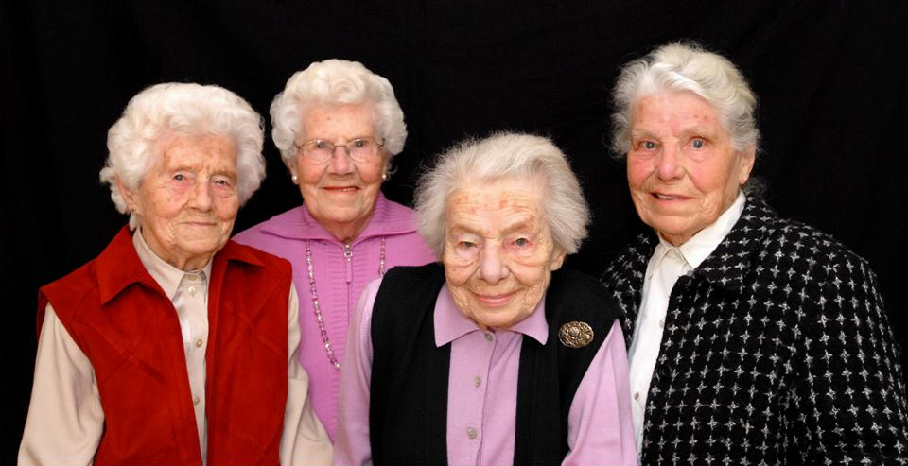
Leiden Longevity Study
Nonagenarian siblings (n = 944)
94 years (89-104)
Controls (partners) (n = 744)
60 years (36-79)
Offspring (n = 1671)
61 years (39-81)
Schoenmaker EJHG 2006

Slide 38

Practical in R => Erik van den Akker
Data exploration
Quality Control
Data transformation
Analysis
Interpretation

